Slide 1
What is Big Data/Hadoop?
Big data is the term for a collection of data sets so large and complex that it becomes difficult to process using on-hand traditional data processing tools.
The Problem is not getting this big data, But to store, process and analyze data.
5V’s of Bigdata
Volume Refers to the vast amounts of data generated.
Velocity Refers to the speed at which new data is generated and the speed at which data moves around.
Variety Refers to the different types of data we can now use.
Veracity refers to the biases, noise and abnormality in data.
Value – Big data is no use unless we can turn it into value.

Slide 2
Big Data Problem Context
Big Data Problem
Storage
Processing
Distributed File System -HDFS
Map Reduce, Hive, Pig, Spark . . .

Slide 3
Apache Hadoop
Apache Hadoop is a framework that allows for the distributed processing of large data sets across clusters of commodity computers using a simple programming model.
It is an Open-source Data Management with scale-out storage & distributed processing.
Storage
HDFS - A distributed file system where commodity hardware can be used to form clusters and store the huge data in distributed fashion. There is no need for high end hardware.
Process
MAP Reduce –JAVA Paradigm
It can easily scale to multiple nodes(1,500–2,000 nodes in a cluster), with just configuration change.

Slide 4
HDFS Definition
HDFS is a distributed, scalable, and portable filesystem written in Java for the Hadoop framework.
HDFS creates multiple replicas of data blocks and distributes them on compute nodes throughout a cluster to enable reliable, extremely rapid computations.
HDFS is highly fault-tolerant and is designed to be deployed on low-cost hardware.
HDFS provides high throughput access to application data and is suitable for applications that have large data sets.
HDFS consists of following components (daemons)
Name Node
Data Node
Secondary Name Node

Slide 5
HDFS Components
NameNode, a master server, manages the file system namespace and regulates access to files by clients. It maintains and manages the blocks which are present on the datanode.
The entire metadata is kept in main memory
During start up the NameNode loads the file system state from the fsimage and the edits log file. It then waits for DataNodes to report their blocks so that it does not prematurely start replicating the blocks though enough replicas already exist in the cluster. During this time NameNode stays in Safemode. Safemode for the NameNode is essentially a read-only mode for the HDFS cluster, where it does not allow any modifications to file system or blocks.
Types of Metadata
List of files, List of Blocks for each file, List of DataNodes for each block
File attributes, e.g. creation time, replication
A Transaction Log like Records file creations, file deletions. Etc.
DataNode, one per node, manages storage attached to the nodes that they run on.
Stores data in the local file system (e.g. ext3)
Stores meta-data of a block (e.g. CRC)
Serves data and meta-data to Clients
Sends block report
Periodically sends a report of all existing blocks to the NameNode
Forwards data to other specified DataNodes (Data Pipeline)

Slide 6
HDFS Components
Secondary NameNode
When a NameNode starts up, it reads HDFS state from fsimage to the memory, and then applies logs from the edits log file. It then writes new HDFS state to an empty edits file. The secondary NameNode merges the fsimage and the edits log files periodically and keeps edits log size within a limit.
It is usually run on a different machine than the primary NameNode since its memory requirements are on the same order as NameNode.
The checkpoint process on the secondary NameNode is controlled by below configuration parameters.
fs.checkpoint.period, set to 1 hour by default, specifies the maximum delay between two consecutive checkpoints
fs.checkpoint.size, set to 64MB by default, defines the size of the edits log file that forces an urgent checkpoint even if the maximum checkpoint delay is not reached.
The secondary NameNode stores the latest checkpoint in a directory which is structured the same way as the primary NameNode's directory. So that the check pointed image is always ready to be read by the primary NameNode if necessary.

Slide 7
HDFS Write
Client Node
Name Node
Client JVM
NameNode
Distributed File System
2: Create
1: Create
HDF client
3: Write
7: Complete
FS Data Output Stream
6: Close
4: Write packet
5: Ack packet
Data Node
Data Node
Data Node
DataNode
4
DataNode
4
DataNode
Pipelines of data nodes
5
5

Slide 8
HDFS Read
Client Node
Name Node
Client JVM
NameNode
Distributed File System
2: Get block locations
1: Open
HDF client
3: Read
FS Data Input Stream
6: Close
4: Read
5: Read
Data Node
Data Node
Data Node
DataNode
DataNode
DataNode

Slide 9
HDFS Write/Read
When a client is writing data to an HDFS file, its data is first written to a local file, Suppose the HDFS file has a replication factor of three, When the local file accumulates a full block of user data, the client retrieves a list of DataNodes from the NameNode. This list (Data pipeline) contains the DataNodes that will host a replica of that block.
The client then flushes the data block to the first DataNode.
The first Datanode starts receiving the data in small portions (64 KB), writes each portion to its local repository and transfers that portion to the second DataNode.
The second DataNode, in turn starts receiving each portion of the data block, writes that portion to its repository and then flushes that portion to the third DataNode.
Finally, the third DataNode writes the data to its local repository. Thus, a DataNode can be receiving data from the previous one in the pipeline and at the same time forwarding data to the next one in the pipeline.
To read/open a file, client contacts the name node retrieves list of locations of blocks of that file. These locations identify data nodes that hold the block. Clients then read the data directly from data nodes in parallel. Name Node is not involved in this stage.

Slide 10
HDFS Features
Data is distributed over several machines, and replicates (default to 3) to ensure their durability to failure and high availability to parallel applications
Designed for very large files (TBs), so possible that a block of data fetched from a datanode arrives corrupted due to faults in a storage device, network faults, or buggy software.
Each block 128Mb in size, this is to keep smaller metadata at name node for each file and reduce seek time.
The HDFS client software implements checksum per 512 byte (CRC32) checking on the contents of HDFS files. When a client creates an HDFS file, it computes a checksum of each block of the file and stores these checksums in a separate hidden file in the same HDFS namespace. (Datanode stores the checksum)
When a client retrieves file contents it verifies that the data it received from each Datanode matches the checksum stored in the associated checksum file. If not matching, then the client retrieves that block from another Datanode that has a replica of that block.
Write once and read many times (write is costly)
Scalable horizontally by adding new nodes

Slide 11
HDFS Limitations
Low-latency data access
HDFS is optimized for delivering a high throughput of data, and this may be at the expense of latency.
Consider using low-latency access tool like Hbase .
Lots of small files
Number of files in a filesystem is governed by the amount of memory on the namenode.
Each file, directory, and block takes about 150 bytes
Reading through small files normally causes lots of seeks and lots of hopping from datanode to datanode to retrieve each small file, all of which is an inefficient data access pattern.
Consider using HAR, Sequence files to alleviate the problem of lots of small files.
Multiple writers
HDFS can have multiple readers read a file on HDFS but only one writer can write to that file.
This model makes that concurrency control requirements more easy to implement.
Arbitrary file modifications
Writes are always made at the end of the file, in append-only fashion.
Coherency Model
A coherency model for a filesystem describes the data visibility of reads and writes for a file.
After creating a file, it is visible in the filesystem namespace
Current block being written that is not visible to other readers.

Slide 12
Parallel Copying with DistCp
DistCp (distributed copy) is a tool used for large inter/intra-cluster copying.
It uses MapReduce to effect its distribution, error handling and recovery, and reporting.
work of copying is done by the maps that run in parallel across the cluster. There are no reducers.
Each file is copied by a single map, and distcp tries to give each map approximately the same amount of data by bucketing files into roughly equal allocations.
DistCp works with Object Stores such as Amazon S3, Azure WASB and OpenStack Swift.
Commands:
hadoop distcp hdfs://nn1:8020/foo/bar hdfs://nn2:8020/bar/foot
hadoop distcp hdfs://nn1:8020/datasets/set1 s3://bucket/datasets/set1
hadoop distcp s3a://bucket/generated/results wasb://updates@example.blob.core.windows.net

Slide 13
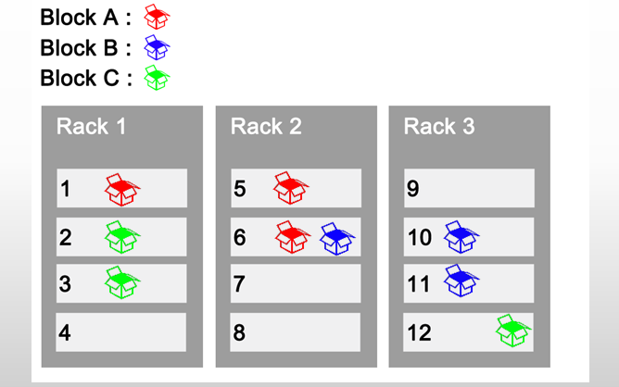
Rack Awareness
Typically large Hadoop clusters are arranged in racks and network traffic between different nodes with in the same rack is much more desirable than network traffic across the racks. In addition NameNode tries to place replicas of block on multiple racks for improved fault tolerance.
One replica on local node
Second replica on a remote rack
Third replica on same remote rack and Additional replicas are randomly placed
Clients read from nearest replica.

Slide 14
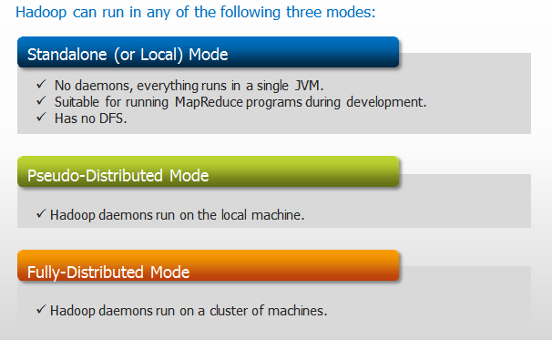
Hadoop Cluster Modes
Web UI URLs
NameNode status: http://localhost:50070/dfshealth.jsp
ResourceManager status: http://localhost:8088/cluster
MapReduce JobHistory Server status: http://localhost:19888/jobhistory

Slide 15
Hadoop Configuration Files
Configuration Filenames | Description of Log Files
hadoop-env.sh | Environment variables that are used in the scripts to run Hadoop.
core-site.xml | Configuration settings for Hadoop Core such as I/O settings that are common to HDFS and MapReduce.
hdfs-site.xml | Configuration settings for HDFS daemons, the namenode, the secondary namenode and the data nodes.
mapred-site.xml | Configuration settings for MapReduce Applications.
yarn-site.xml | Configuration settings for ResourceManager and NodeManager.
masters | Contains a list of hosts, one per line, that are to host Secondary NameNode servers.
slaves | A list of machines (one per line) that each run a Datanode and a NodeManager.

Slide 16
Important Hadoop properties
All Properties
https://hadoop.apache.org/docs/current/hadoop-project-dist/hadoop-common/core-default.xml
https://hadoop.apache.org/docs/current/hadoop-project-dist/hadoop-hdfs/hdfs-default.xml
https://hadoop.apache.org/docs/current/hadoop-mapreduce-client/hadoop-mapreduce-client-core/mapred-default.xml
https://hadoop.apache.org/docs/current/hadoop-yarn/hadoop-yarn-common/yarn-default.xml
https://hadoop.apache.org/docs/current/hadoop-project-dist/hadoop-common/DeprecatedProperties.html

Slide 17
HDFS Federation
The NameNode keeps a reference to every file and block in the filesystem in it’s main memory, which means that on very large clusters with many files, memory becomes the limiting factor for scaling.
HDFS federation, introduced in the 2.x release series, allows a cluster to add multiple NameNodes, each of which manages a portion of the filesystem namespace. For example, one NameNode might manage all the files rooted under /Marketing, say, and a second NameNode might handle files under /Sales.
Under federation, each NameNode manages a namespace volume, which is made up of the metadata for the namespace, and a block pool containing all the blocks for the files in the namespace.
Namespace volumes are independent of each other, which means NameNodes do not communicate with one another, and furthermore the failure of one NameNode does not affect the availability of the namespaces managed by other NameNodes.
Block pool storage is not partitioned, so datanodes register with each NameNode in the cluster and store blocks from multiple block pools.

Slide 18
HDFS High Availability
Prior to Hadoop 2.0, the NameNode was a single point of failure (SPOF) in an HDFS cluster as each cluster had a single NameNode, and if that machine or process became unavailable, the cluster as a whole would be unavailable until the NameNode was either restarted or brought up on a separate machine until NameNode comes out of Safemode.
This impacted the total availability of the HDFS cluster in two major ways:
In case of unplanned event like machine crash, the cluster would be unavailable.
Planned maintenance events such as software or hardware upgrades on the NameNode machine would result in cluster downtime.
The HDFS High Availability feature addresses the above problems by providing the option of running two separate machines are configured as NameNodes. However at any point in time, exactly one of the NameNodes is in an Active state, and the other is in a Standby state. The Active NameNode is responsible for all client operations in the cluster, while the Standby is simply acting as a slave, maintaining enough state to provide a fast failover if necessary. In order to provide a fast failover, the DataNodes are configured with the location of both NameNodes, and send block location information and heartbeats to both.Note that, in an HA cluster, the Standby NameNode also performs checkpoints of the namespace state, and thus it is not necessary to run a Secondary NameNode.

Slide 19
HA (NFS )
NFS for shared storage
When any namespace modification is performed by the Active node, it durably logs a record of the modification to an edit log file stored in the shared directory (NFS). Typically this is a remote filer which supports NFS and is mounted on each of the NameNode machines. The Standby node is constantly watching this directory for edits, and as it sees the edits, it applies them to its own namespace.
In the event of a failover, the Standby will ensure that it has read all of the edits from the shared storage before promoting itself to the Active state. This ensures that the namespace state is fully synchronized before a failover occurs.
Currently only a single shared edits directory is supported. Because of this, it is recommended that the shared storage server be a high-quality dedicated NAS appliance rather than a simple Linux server.

Slide 20
HA (QJM)
Quorum Journal Manager (QJM)
In order for the Standby NameNode to keep its state synchronized with the Active node, both NameNodes communicate with a group of separate daemons called “JournalNodes” (JNs). When any namespace modification is performed by the Active node, it durably logs a record of the modification to a majority of these JNs. The Standby node is capable of reading the edits from the JNs, and is constantly watching them for changes to the edit log. As the Standby Node sees the edits, it applies them to its own namespace.
In the event of a failover, the Standby will ensure that it has read all of the edits from the JournalNodes before promoting itself to the Active state. This ensures that the namespace state is fully synchronized before a failover occurs.
you should run an odd number of JNs, (i.e. 3, 5, 7, etc.). Note that when running with N JournalNodes, the system can tolerate at most (N - 1) / 2 failures and continue to function normally.
QJM (recommended choice) Vs NFS
The QJM only allows one namenode to write to the edit log at one time.
System can tolerate the loss of journal nodes provided off 50+% nodes are available.

Slide 21
Automatic failover
In HA mode, the system will not automatically trigger a failover from the active to the standby NameNode, even if the active node has failed. It needs, Apache ZooKeeper which is a highly available service for maintaining small amounts of coordination data, notifying clients of changes in that data, and monitoring clients for failures. The implementation of automatic HDFS failover relies on ZooKeeper for the following things:
Failure detection - each of the NameNode machines in the cluster maintains a persistent session in ZooKeeper. If the machine crashes, the ZooKeeper session will expire, notifying the other NameNode that a failover should be triggered.
Active NameNode election - ZooKeeper provides a simple mechanism to exclusively elect a node as active. If the current active NameNode crashes, another node may take a special exclusive lock in ZooKeeper indicating that it should become the next active.

Slide 22
Hands On- Hadoop FS Commands
Move the directory 1-Data to your home directory, i.e./home/<username> using winscp.
Return the help for an individual command.
hadoop fs -usage
Append single/multiple sources from local file system to the destination file system.
hadoop fs -appendToFile SampleDataFile/player_2008.csv SampleDataFile/player_2007.csv /user/cloudera/cricdata_merged.txt
To view contents of text file which is present in hadoop directory.
hadoop fs -cat cricdata_merged.txt
hadoop fs -cat -ignoreCrc cricdata_merged.txt
The -ignoreCrc option disables checkshum verification
hadoop fs -tail cricdata_merged.txt
(Displays last kilobyte of the file)

Slide 23
HDFS FS Commands
Create a file of zero length
hadoop fs -touchz file1.txt
An error is returned if the file exists with non-zero length.
Count the number of directories, files and bytes under the paths that match the specified file
hadoop fs -count /user/cloudera
hadoop fs -count -q /user/cloudera/
(-q means show quotas)
hadoop fs -count -q -h /user/cloudera/
(-h option shows sizes in human readable format)
hadoop fs -count -q -h -v /user/cloudera/
(The -v option displays a header line)

Slide 24
HDFS FS Commands
List the contents of the root directory in HDFS
hadoop fs -ls /
-C: Display the paths of files and directories only.
-h: Format file sizes in a human-readable fashion
-R: Recursively list subdirectories encountered.
-t: Sort output by modification time (most recent first).
-S: Sort output by file size.
-r: Reverse the sort order.
Create a new directory in HDFS.
hadoop fs -mkdir hadoopdata
Add file from local directory to directory “hadoopdata” created in HDFS
hadoop fs -put SampleDataFile/ hadoopdata/
Add file from HDFS directory to the local home directory
hadoop fs -get hadoopdata/SampleDataFile

Slide 25
HDFS FS Commands
Copy/move/delete files from source to destination.
hadoop fs -cp hadoopdata/SampleDataFile/CricketScore.txt /user/cloudera
hadoop fs -cp -f hadoopdata/SampleDataFile/CricketScore.txt /user/cloudera/
The -f option will overwrite the destination if it already exists.
hadoop fs -mv hadoopdata/SampleDataFile/CricketScore.txt /user/cloudera/
hadoop fs -rm CricketScore.txt
hadoop fs -rm hadoopdata/SampleDataFile/* (Delete all files from directory)
hadoop fs -rm -r hadoopdata/SampleDataFile (remove the entire directory and all of its contents )
hadoop fs -rmdir hadoopdata/SampleDataFile (Deletes empty directory)
Finds all files that match the specified expression and applies selected actions to them.
hadoop fs -find SampleDataFile/ -name CricketScore.txt
Reference
https://hadoop.apache.org/docs/current/hadoop-project-dist/hadoop-common/FileSystemShell.html

Slide 26
HDFS Admin Commands
Displays free space.
hdfs dfs -df SampleDataFile
hdfs dfs -df hdfs:/
Report the amount of space used and available on currently mounted filesystem
Displays sizes/length of files and directories
hadoop fs -du /user/cloudera
The -s option will result the calculation done by going 1-level deep from the given path rather than the individual files
The -h option will format file sizes in a “human-readable” fashion
Run a DFS filesystem checking utility reporting missing or under replicated blocks.
hdfs fsck /user/cloudera
Balancer analyzes block placement and rebalances data across the Datanode.
hdfs balancer
Reference
https://hadoop.apache.org/docs/current/hadoop-project-dist/hadoop-hdfs/HDFSCommands.html

Slide 27
HDFS Admin Commands
Returns the checksum information of a file.
hadoop fs -checksum /user/cloudera/CricketScore.txt
Command to make the name node leave safe mode
hdfs dfsadmin -safemode leave
Recommission or decommission DataNode(s)
hadoop dfsadmin -refreshNodes (After adding the IP Address to slave file)
To empty the trash
hadoop fs -expunge
When a file is deleted by a user or an application, it is not immediately removed from HDFS. Instead, HDFS first renames it to a file in the /trash directory. The file can be restored quickly as long as it remains in /trash. After the expiry of its life in /trash, the NameNode deletes the file from the HDFS namespace. The deletion of a file causes the blocks associated with the file to be freed.
Note that there could be an appreciable time delay between the time a file is deleted by a user and the time of the corresponding increase in free space in HDFS.
The /trash directory contains only the latest copy of the file that was deleted.

Slide 28
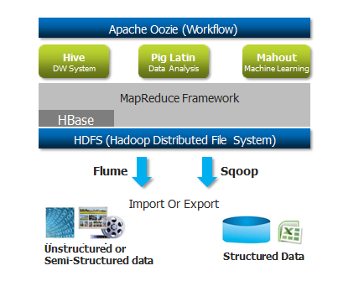
Hadoop Eco System

